Slide 1
Configuring Access Control
K. Vignesh
22H51AO593

Slide 2
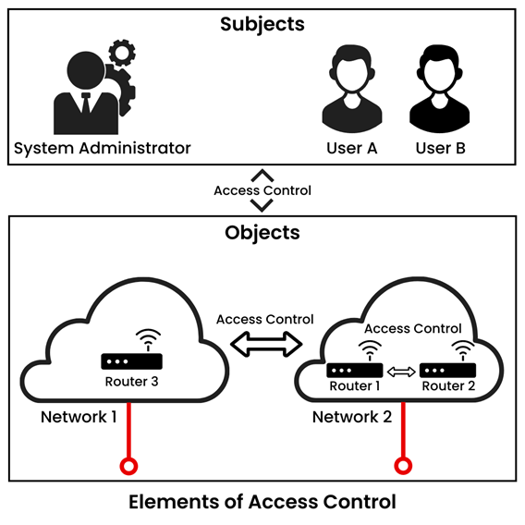
Introduction to Access Control
Access control is a fundamental security mechanism used to regulate who can access resources.
It ensures that only authorized users can access sensitive data and systems.
Understanding access control is essential for protecting information and maintaining compliance.
1
Notes:
Image source: https://www.lumenci.com/post/access-control-mechanisms

Slide 3
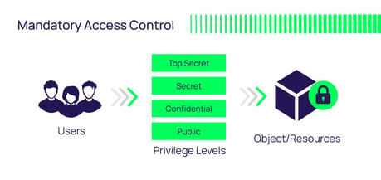
Types of Access Control Models
There are three primary access control models: Mandatory Access Control (MAC), Discretionary Access Control (DAC), and Role-Based Access Control (RBAC).
MAC restricts access based on system-enforced policies, whereas DAC allows users to control access to their own resources.
RBAC simplifies management by allowing permissions based on user roles within an organization.
2
Notes:
Image source: https://delinea.com/blog/access-control-models-methods

Slide 4
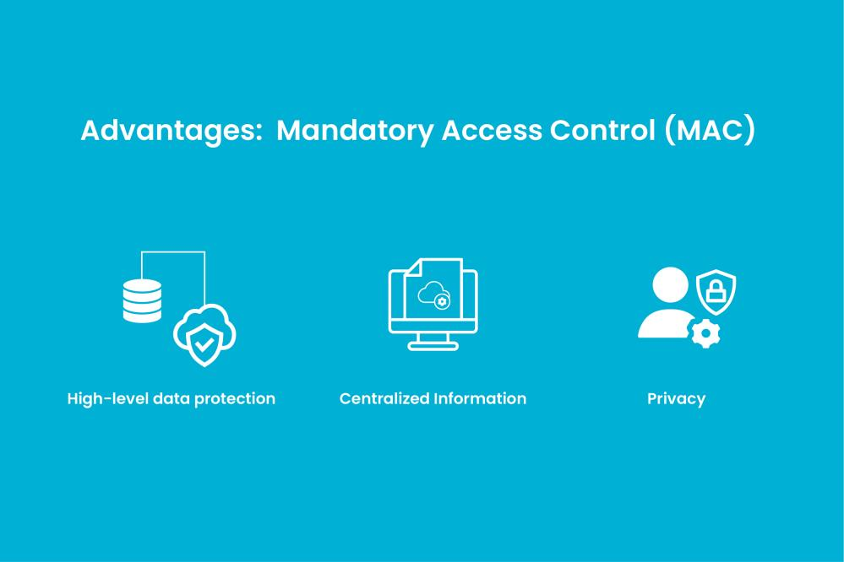
Mandatory Access Control (MAC)
MAC is a highly secure model where access to resources is governed by a central authority.
Users cannot change access permissions; they are strictly assigned based on security labels.
This model is often used in government and military environments where data sensitivity is critical.
3
Notes:
Image source: https://www.pinnaxis.com/?k=mandatory-mac-vs-discretionary-access-control-dac-differences-ekran-ee-BYNe9qFa

Slide 5
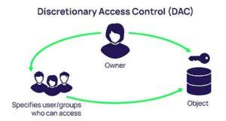
Discretionary Access Control (DAC)
DAC allows users to control access to their own resources, granting permissions at their discretion.
This model is flexible but can lead to security risks if users inadvertently grant access to unauthorized individuals.
DAC is commonly used in file-sharing systems and personal data management.
4
Notes:
Image source: https://securityboulevard.com/2022/12/6-examples-of-discretionary-access-control-dac/

Slide 6
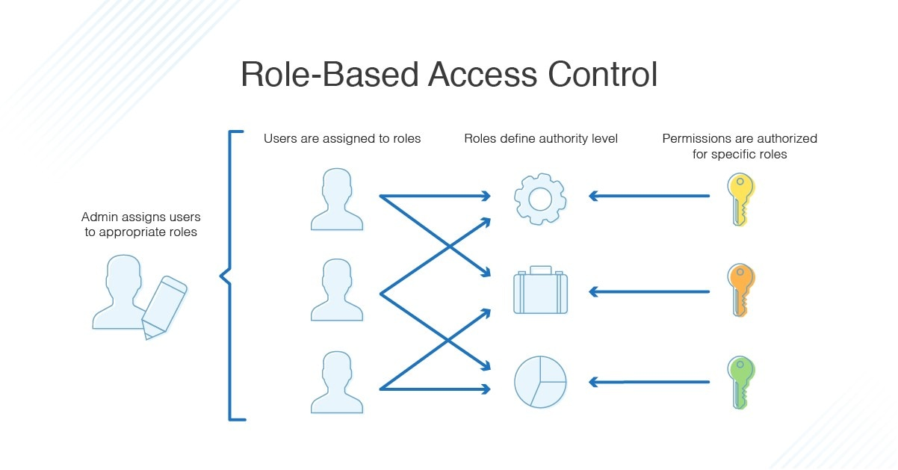
Role-Based Access Control (RBAC)
RBAC assigns permissions based on user roles, simplifying the management of access rights.
It enhances security by ensuring that users only have access to the information necessary for their job functions.
RBAC is widely adopted in enterprises to streamline user management and reduce administrative overhead.
5
Notes:
Image source: https://d18d9sahwvtdqs.cloudfront.net/guides/rbac-vs-abac

Slide 7
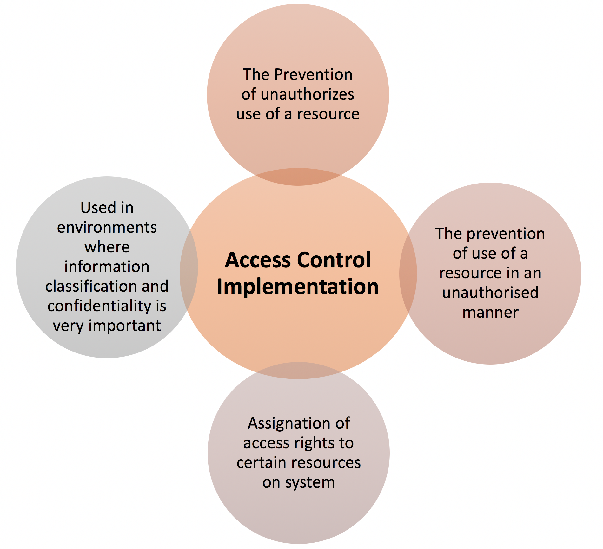
Implementing Access Control Policies
Effective access control begins with defining clear policies that outline who can access what resources.
Policies should be regularly reviewed and updated to reflect changes in user roles and organizational needs.
Training employees on access control procedures is crucial for minimizing human error and maintaining security.
6
Notes:
Image source: http://www.xorlogics.com/2018/10/01/6-tips-for-implementing-access-control-authentication-system-with-security/

Slide 8
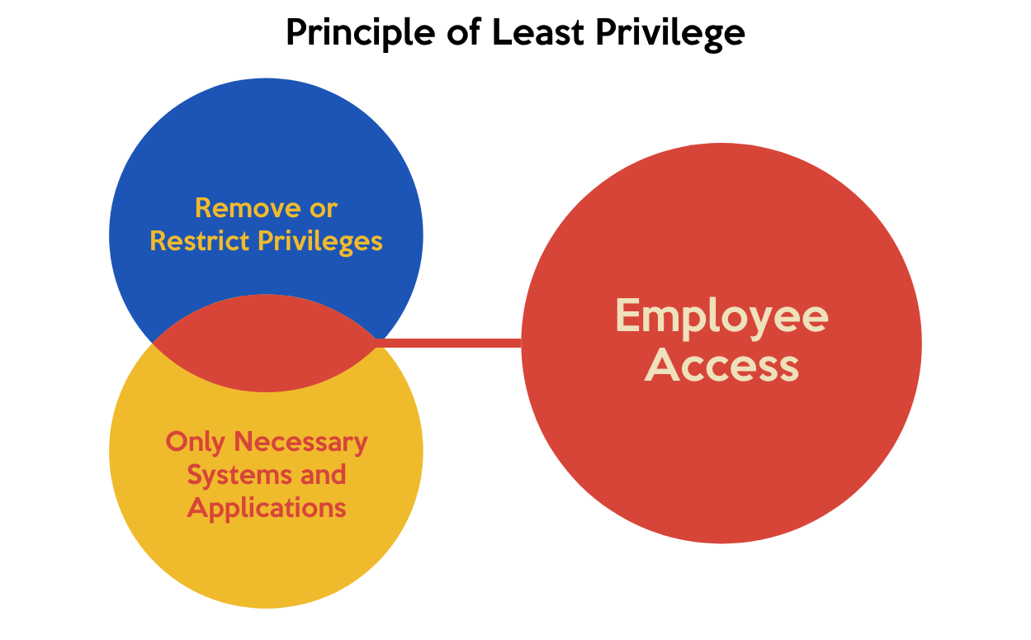
Best Practices for Access Control
Implement the principle of least privilege, allowing users only the access necessary for their roles.
Regularly audit access controls and permissions to identify and rectify any discrepancies.
Utilize multi-factor authentication to add an additional layer of security for accessing sensitive resources.
7
Notes:
Image source: https://www.horangi.com/blog/least-privilege-policy

Slide 9
Conclusion and Future Trends
Access control is an ongoing process that requires continuous assessment and adaptation to new threats.
Future trends include the integration of AI and machine learning to enhance access control mechanisms.
Organizations must stay informed about emerging technologies and practices to maintain robust access control systems.
8
Notes:
Image source: https://www.gartner.com/en/articles/iam-leaders-plan-to-adopt-these-6-identity-and-access-management-trends

Slide 10
THANK YOU

